Slide 1

C PROJECT ON
“QUIZ GAME”
SUBMITTED TO: SUBMITTED BY:
Dr. Syamala Devi RINKI MCA –1 (Morning) Roll No - 33

Slide 2
An entertainment in which the general or specific knowledge of the player is tested by a series of questions, as like as radio or television program or mobile game
A quiz is a game that can also be a mind sport where the players, either as an individual or in teams attempt to answer questions.
By Playing this game a person can gather his knowledge in a different field
WHAT IS QUIZ GAME
ABOUT THE GAME

Slide 3
Quiz Game in C is a mini project which
has been divided into many functions, and
listed below are some of those which may
help you understand the project better.
In this quiz game mini-project, you can
Store the user name, view the highest score
secured by a user and even reset the score.
Additionally, to make the game look a little more interesting, it is divided into three levels. Users can play any level any number of times.
The questions are placed in each file according to the level selected
and the score is calculated by awarding 4 marks for each right answer and zero marks for a wrong answer. In the end, the user can see his/her performance through results and can even check the score of all the users who played.
INTRODUCTION

Slide 4
Project Description
The C project on “Quiz Game” opens up with the main menu window with the option to start the game, view the highest score, reset the score, show the data of the players, help, and an option to quit the quiz. The game is divided into three levels, easy, medium, and hard. The player can choose any level any number of times. The score generated after selecting the options from the multiple-choice questions will be automatically saved in the database created for storing the data of the players. After the questions are answered and the score is generated, the player can check the result also if needed. The player with the highest score can be seen by viewing the highest score option. The player can read the rules of the game by going to the help section. To check the score of other players, all the data stored in the database can also be accessed. When the player is done playing, he/she can exit from the game by selecting the quit option.
The questions displayed for each level are randomly selected from their respective files and the result of every player is stored in another file to be displayed. A file is maintained for storing the data of all the players and to display the highest score. e

Slide 5
start()- it is used for play the quiz
which is having the three levels
help() – help menu with game
summary and rules
reset_score() – to reset the file
in which all player names with the score
is written.
show_score() – to view the highest score
display()- it displays the all player name with the score who has played this game in the sorted form.
quit()- it is used to quit the game.
MODULES

Slide 6
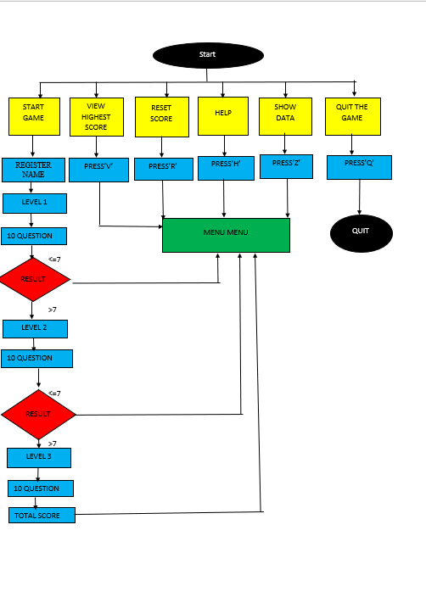
FLOWCHART

Slide 7
Subroutines and Their Outputs

Slide 8
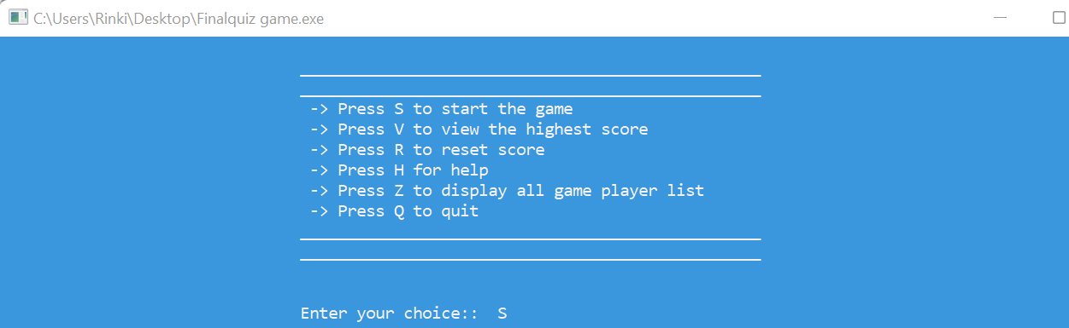
First screen of the quiz game

Slide 9
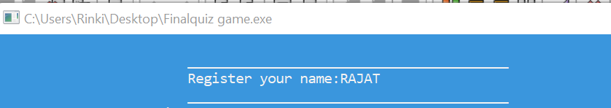
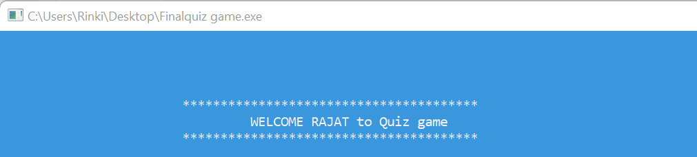
When you choose the option one ”S”
Registering the name of the player
Welcome screen to the player

Slide 10
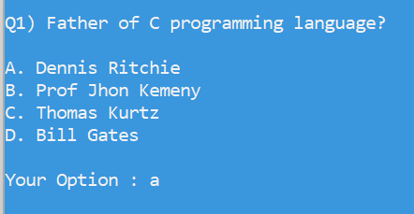
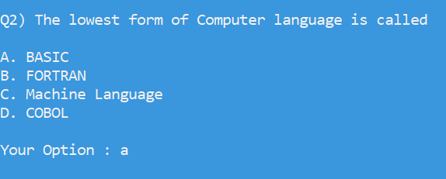
After that first level will pe appear, 10 questions are randomly picked from the file containing all the questions and are displayed on the screen one by one.
The player can select any one option out of the given four options.
Like this:
After all 10 questions it will show the which answer is correct or which answer is not correct . If you give and correct answer of any 7 question you will reached to next level. Otherwise you will come to main menu. And each question willgive you the four marks.

Slide 11
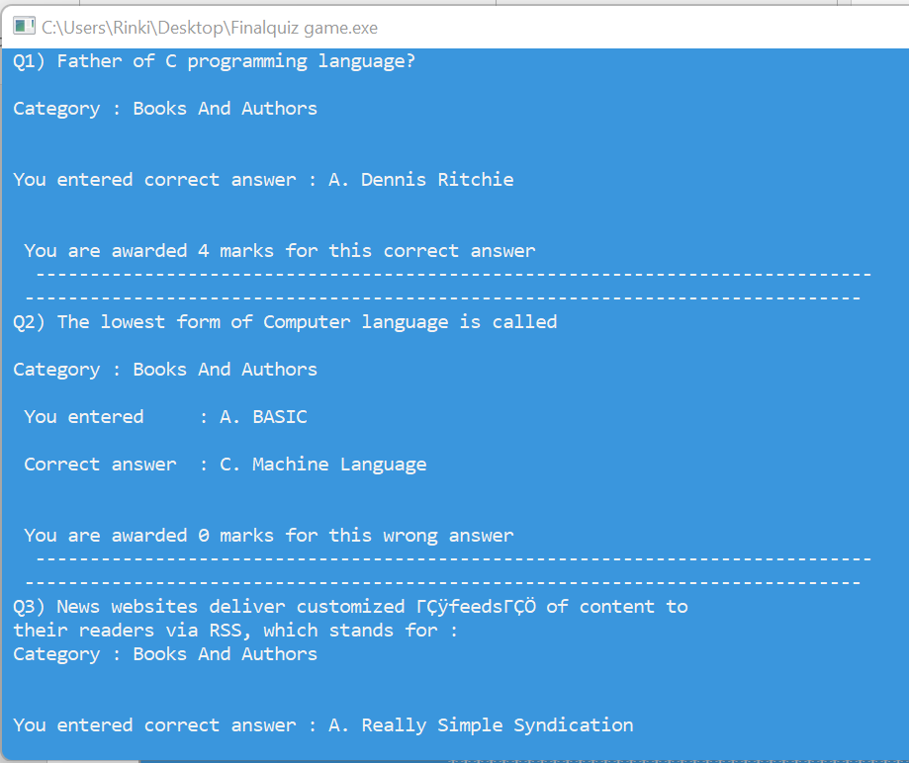

Slide 12
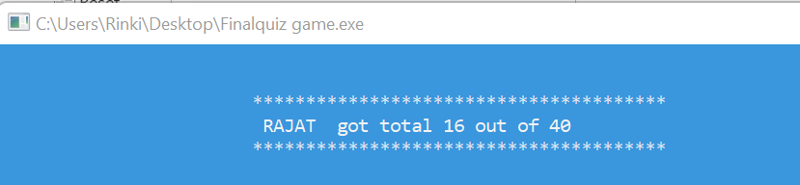
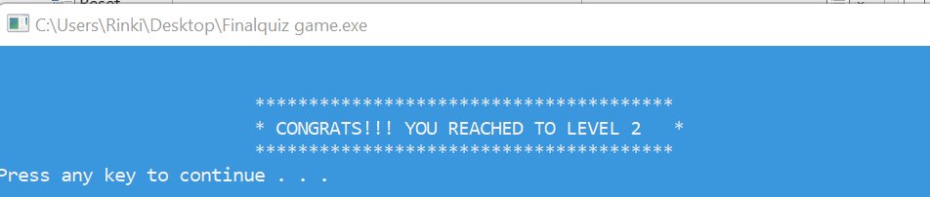
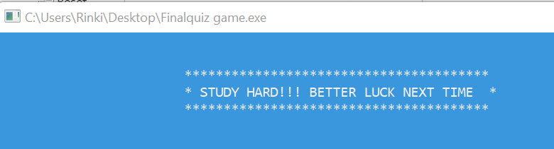
If he score greater than 28 then they reched to next level that is level 2 else message will be appear and then afet press any come to main menu.
IF (score> 28)
else

Slide 13
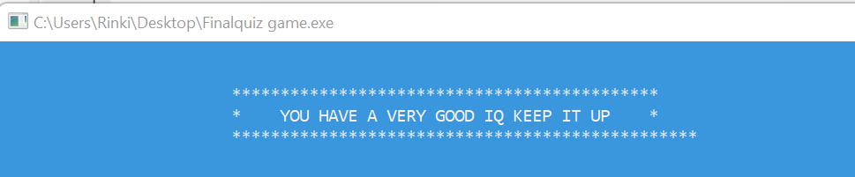
As like the above level one , level 2 is also same . It used the same concept that if you score greater than 28 you will reached to next level else you will come to main menu.
If you complete all the three levels it will the message screen and come back to the main menu.

Slide 14
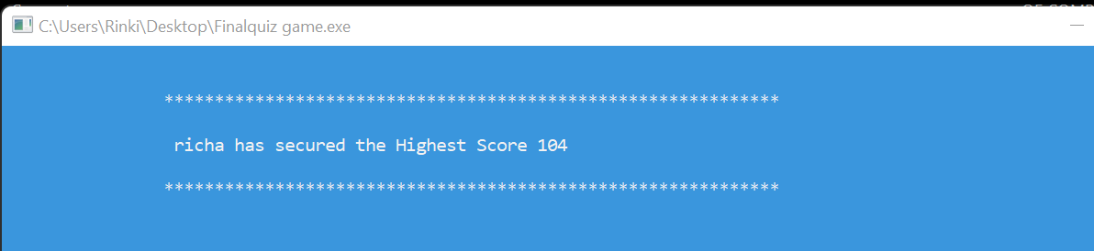
When you choose the option second ”V”

Slide 15
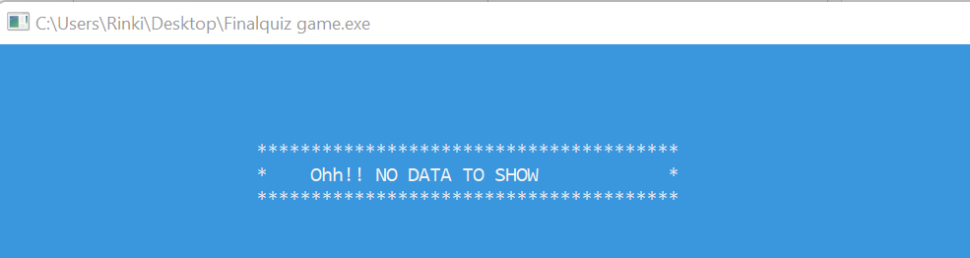
When you choose the option second ”R”

Slide 16
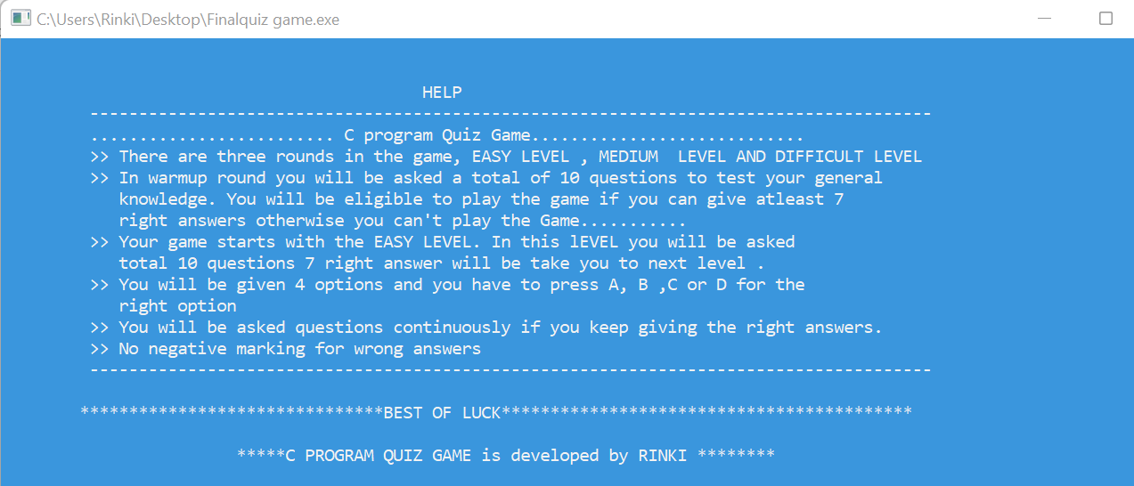
When you choose the option second ”H”

Slide 17
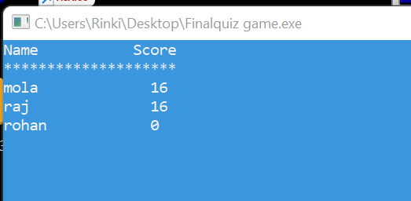
When you choose the option second ”Z”

Slide 18
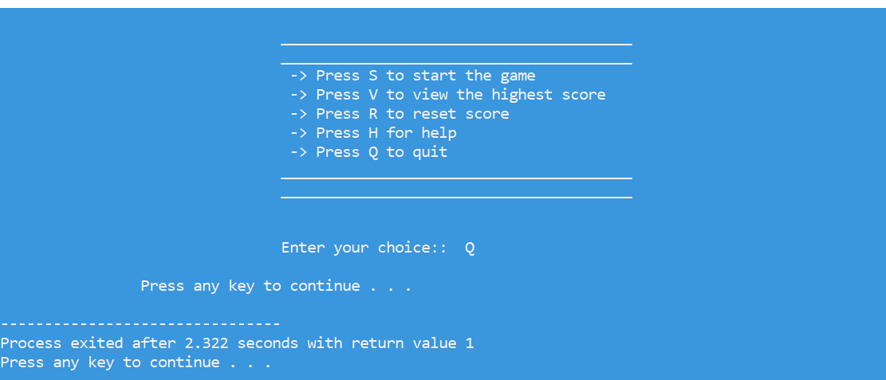
When you choose the option second ”Q”

Slide 19
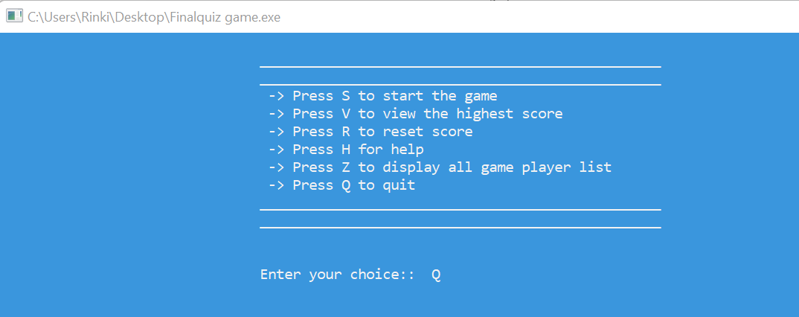
When you choose the option second ”Q”

Slide 20
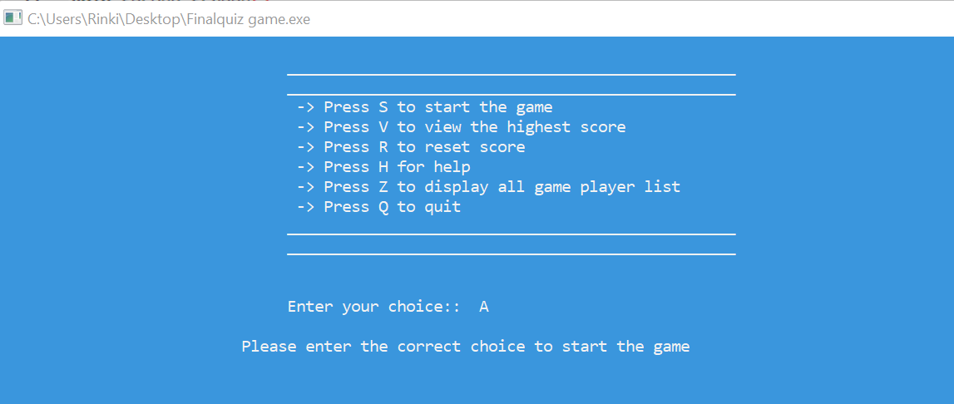
Validation on User choice:
TESTING WITH VALIDATION

Slide 21
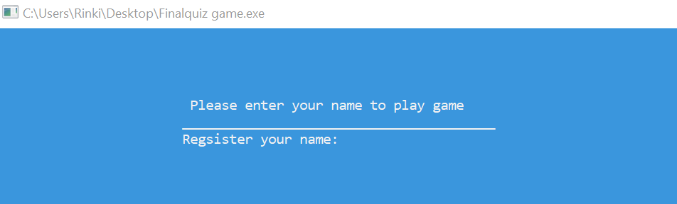
Validation on name:
TESTING WITH VALIDATION

Slide 22
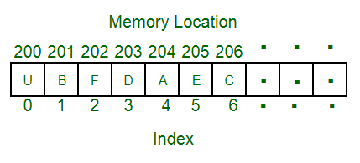
ARRAY:
An array is a collection of items stored at contiguous memory locations. The idea is to store multiple items of the same type together. This makes it easier to calculate the position of each element by simply adding an offset to a base value, i.e., the memory location of the first element of the array (generally denoted by the name of the array).
DATA STRUCTURE USED

Slide 23
SIGNIFICANCE OF THE PROJECT
To Education and Research:
My project “Quiz Game” has great significance as far as education and research are concerned. Being a student, I know about the problems that arise while researching and being educated. Students and research scholars find it difficult to follow the step to enhance their skills. The simplicity of this project would make them more interested in the project and they will try to learn and would also try to implement their knowledge. So , this way my project can serve the area of Education and Research.
To society:
The quiz game project is designed in Dev C++ to test the general knowledge of the user. It contains the questions from all the fiels. The user can gain knowledge from my project by playing different levels of the quiz and improve his/her score.
This quiz can help the user prepare
for any general knowledge exams
with different field of questions
. So, in this way my project
“Quiz Game”has
significance to
the society.
To IT community:
Although my project is
very basic, but still it can be of some significance to IT community. Based on my idea for this project, IT community can think of preparing a Quiz Game that will be more knowledgeable, faster. Many beginners in the IT field can use platform like GitHub to seek knowledge and many IT professionals can help me improving the project marginally. Whatever you develop there is always a scope. and I hope I might contribute something to strengthen the IT field and provide knowledge
to the aspiring
students
.

Slide 24
END OF PROJECT

